Slide 1



Container Monitoring & Dashboards
Container Enablement Workshop
Paul Clement
VP Operations & Partner
paul.clement@pinimbus.com
(760) 613-4795

Slide 2
Container Monitoring & Dashboards
1. | Monitoring Infrastructure in Kubernetes
2. | Monitoring Applications in Kubernetes
3. | Additional Monitoring & Dashboard Tools
4. | DEMO: Monitoring & Dashboard for Containers

Slide 3
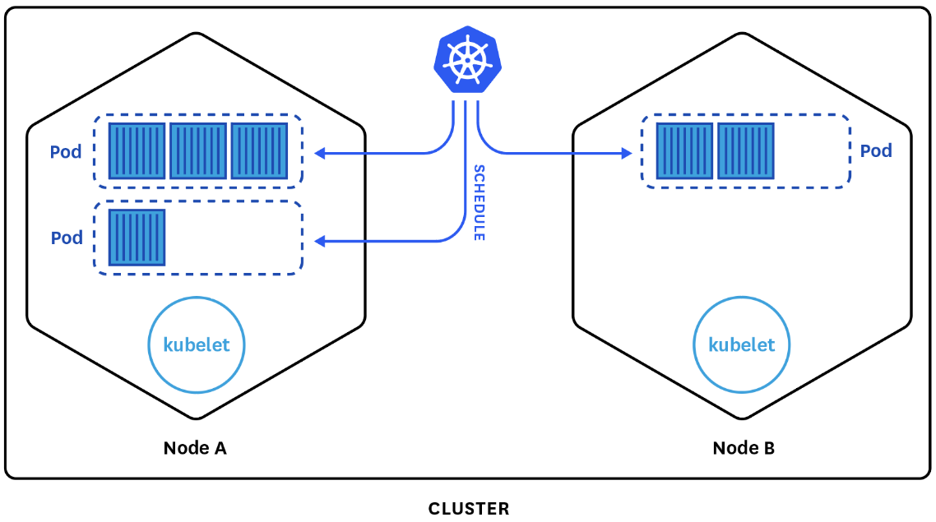
Monitoring in Kubernetes
Kubernetes makes managing a containerized infrastructure much easier by creating levels of abstractions such as pods and services.
It is no longer necessary to worry about location and resource allocation of applications.
Still, ensuring good performance, requires monitoring of applications, the containers running them, and Kubernetes itself.
Monitoring Kubernetes is different than traditional monitoring in several ways:
Tags and labels become essential
More components to monitor
Need to track applications that are constantly moving
Applications may be distributed across multiple cloud providers

Slide 4
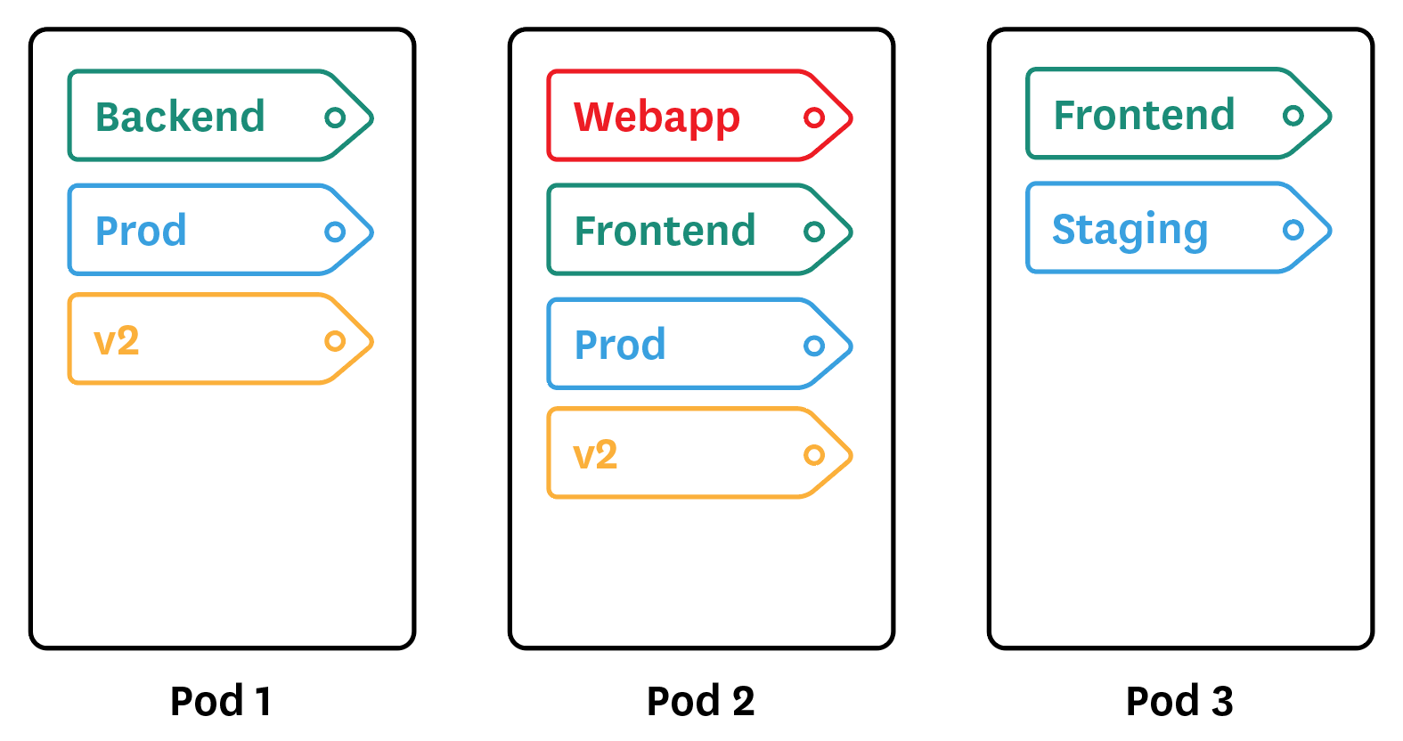
Monitoring in Kubernetes
Tags and labels become essential
labels are the only way to identify pods and their containers.
Pods should be labeled in a way to allow lookup of any aspect of the containerized infrastructure:
Frontend/Backend
Application (website, mobile app, database, cache…)
Environment (prod, staging, dev…)
Team
Version
By default, Kubernetes also exposes basic information about pods (pod_id, pod_name, pod_namespace), containers (container_base_image, container_name), and nodes (host_id, hostname), as well as namespace, service name, and replication controller name.
Some monitoring tools can ingest these attributes and turn them into tags to be used just like other custom Kubernetes labels.

Slide 5
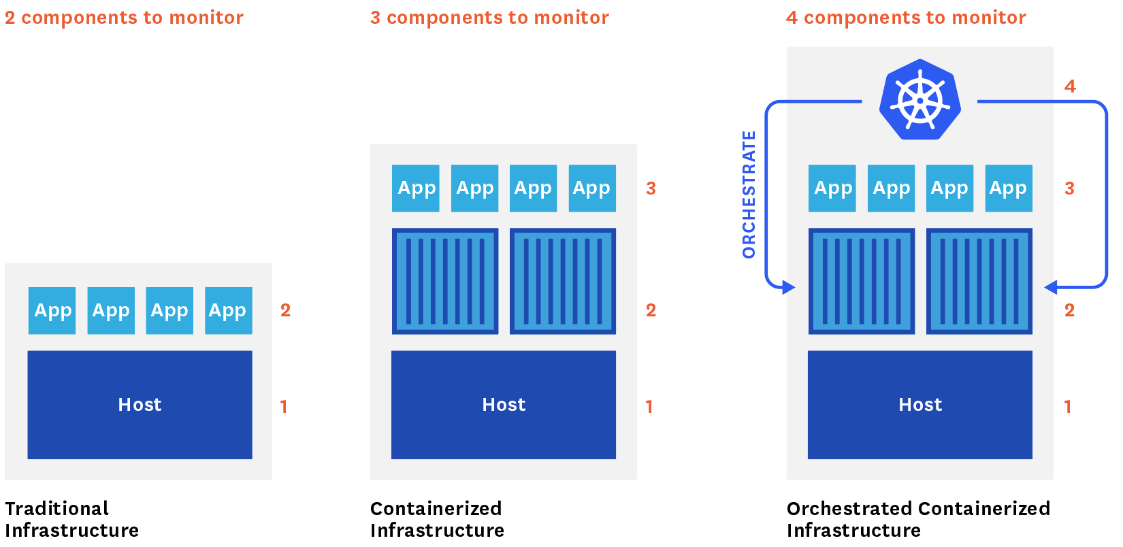
Monitoring in Kubernetes
More components to monitor
When running Kuberenetes, 4 different components need to be monitored, each with their specificities and challenges:
Host
Containers
Containerized Applications
Kubernetes itself

Slide 6
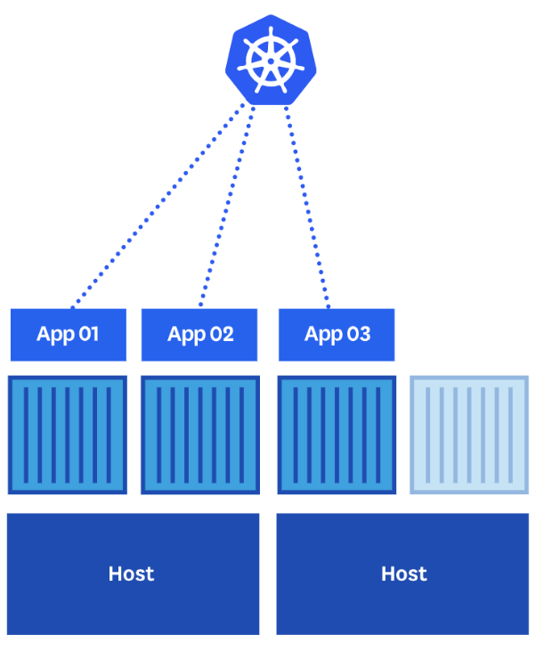
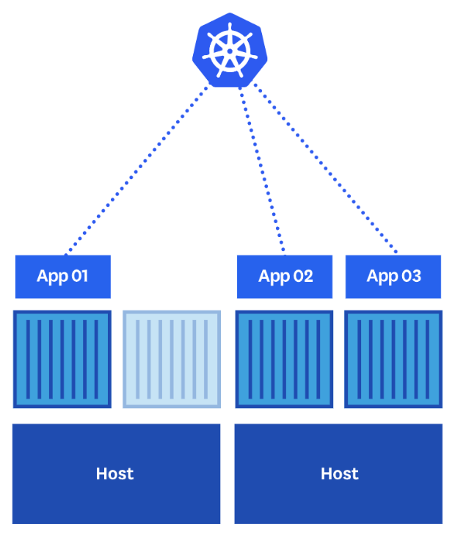
Monitoring in Kubernetes
Applications are moving
Kubernetes, which automatically schedules containers, limits user control over where they are running.
Service Discovery mechanisms become essential for monitoring.
It would detect any change in the pod and container configuration and automatically adapt the metric collection
Allowing for continuous monitoring of the containerized infrastructure with no interruption even as it expands, contracts, or shifts across hosts.
Monitoring has to follow the moving applications

Slide 7
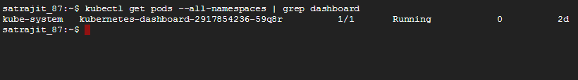
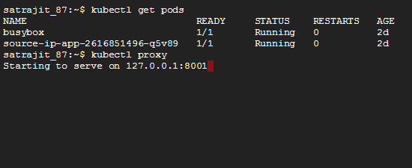
Monitoring Infrastructure in Kubernetes
Kubernetes Dashboard
A general purpose, web-based UI for Kubernetes clusters. It allows users to manage applications running in the cluster and troubleshoot them, as well as manage the cluster itself.
Deployment: likely that the Dashboard is already installed on your cluster.
Usage: run proxy and access at localhost:{port-id}/ui
Notes:
Move this goal to module 2

Slide 8
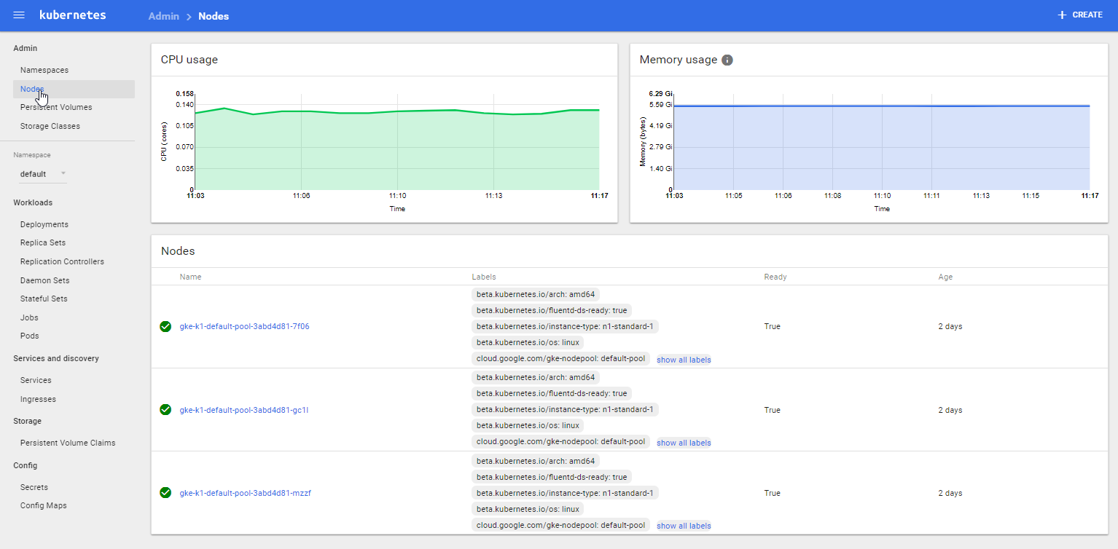
Monitoring Infrastructure in Kubernetes
Kubernetes Dashboard
Nodes
Notes:
Move this goal to module 2

Slide 9
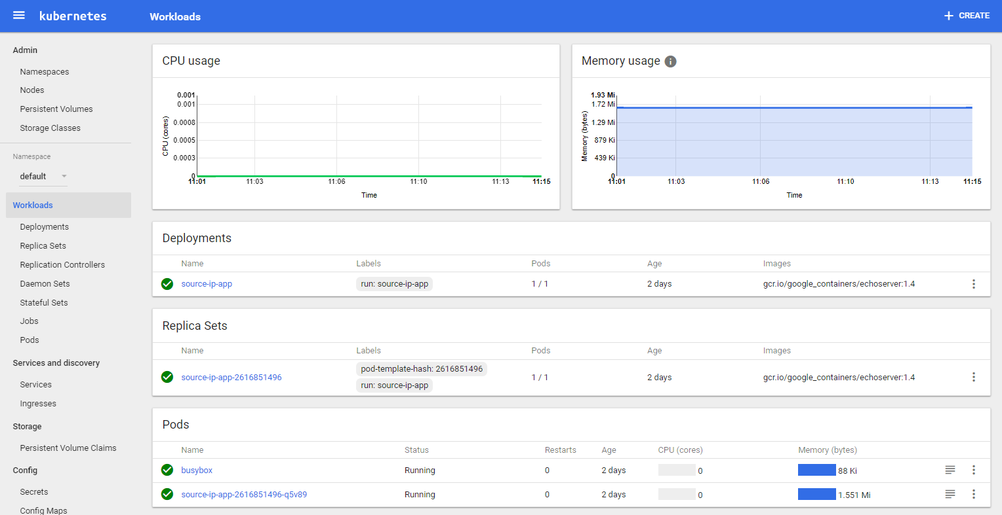
Monitoring Infrastructure in Kubernetes
Kubernetes Dashboard
Usage: run proxy and access at localhost:{port-id}/ui
Workloads
Notes:
Move this goal to module 2

Slide 10
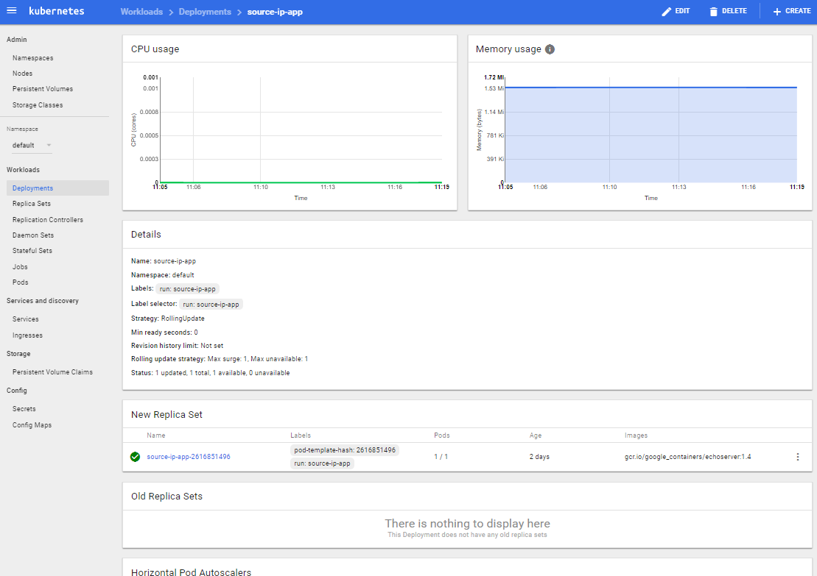
Monitoring Infrastructure in Kubernetes
Kubernetes Dashboard
Deployment Details
Notes:
Move this goal to module 2

Slide 11
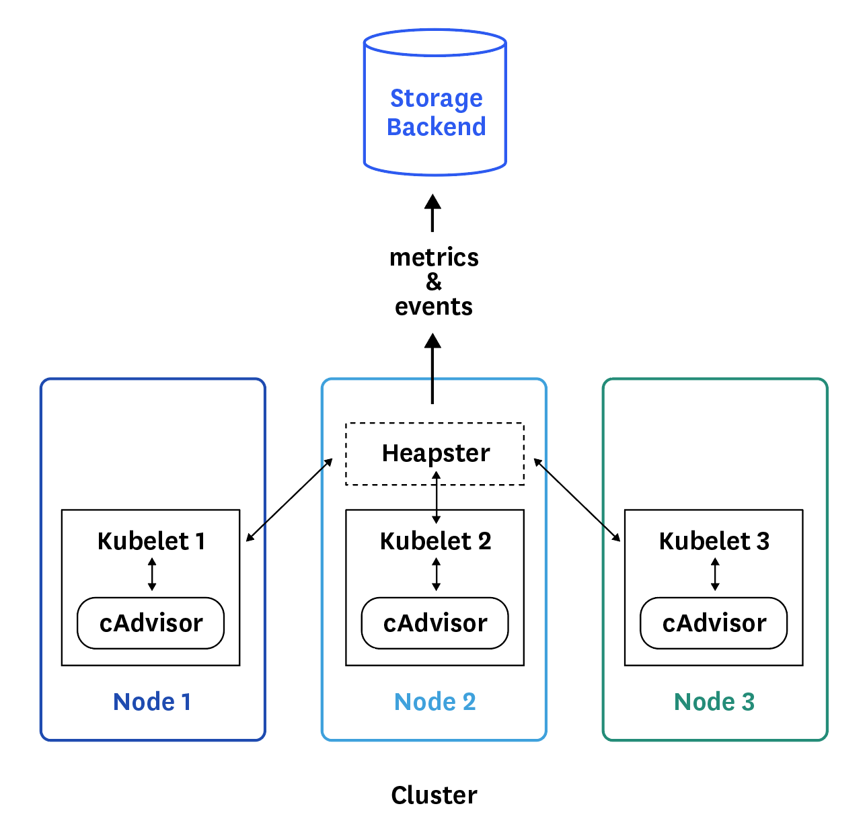
Monitoring Infrastructure in Kubernetes
Heapster: Kubernetes’ own metrics collector
Heapster is the go-to source for basic resource utilization metrics and events from your Kubernetes clusters.
On each node, cAdvisor collects data about running containers that Heapster then queries through the node’s kubelet.
cAdvisor is an open source agent that is integrated into the kubelet of a node.
cAdvisor automatically discovers all the containers running, and collects data about them:
CPU
Memory
file system
Network
cAdvisor also collects data about itself and the Docker daemon.
The kubelet exports these data and re-exposes them via API.
Heapster runs as a pod on Kubernetes like any other application.
Heapster pod discovers all the nodes in the same cluster and then pulls metrics from the kubelet of each node, aggregates them by pod and label, and reports metrics to a monitoring service or storage backend.
Notes:
Move this goal to module 2

Slide 12
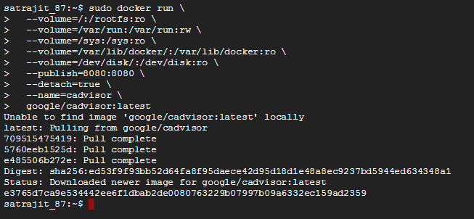


Monitoring Infrastructure in Kubernetes
cAdvisor
cAdvisor (Container Advisor) provides container users an understanding of the resource usage and performance characteristics of their running containers.
It is a running daemon that collects, aggregates, processes, and exports information about running containers.
Specifically, for each container it keeps resource isolation parameters, historical resource usage, histograms of complete historical resource usage and network statistics.
This data is exported by container and machine-wide.
cAdvisor has native support for Docker containers and should support just about any other container type out of the box.
cAdvisor's container abstraction is based on lmctfy's so containers are inherently nested hierarchically.
cAdvisor is available as a Docker image and can be run to monitor the whole machine.
cAdvisor Dashboard made available at localhost:8080
Notes:
Move this goal to module 2

Slide 13
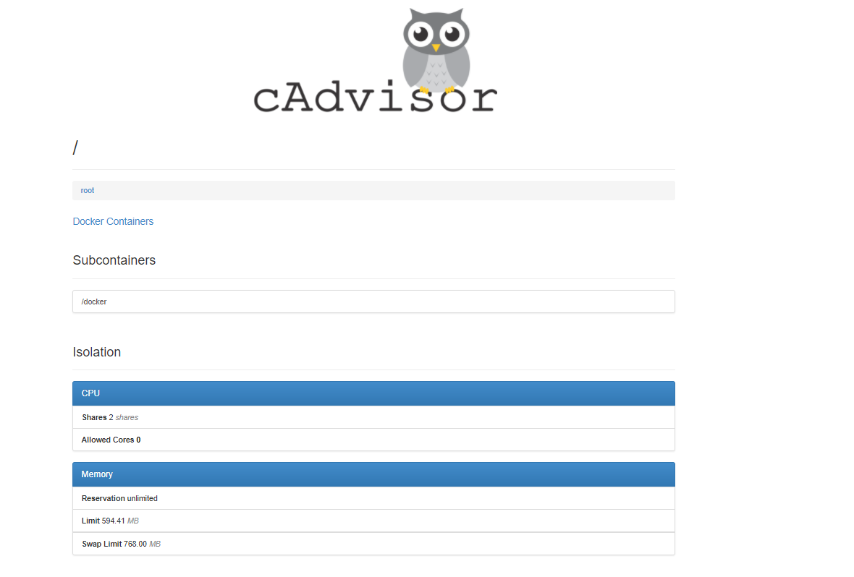
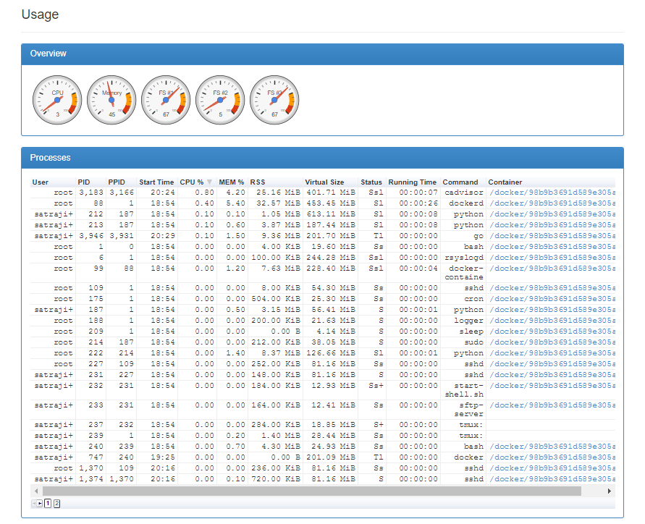
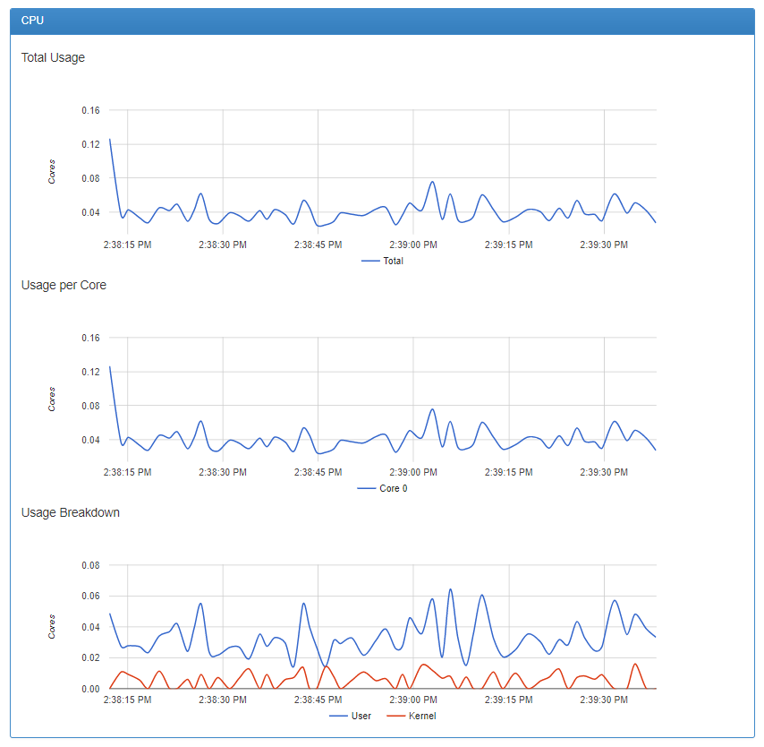
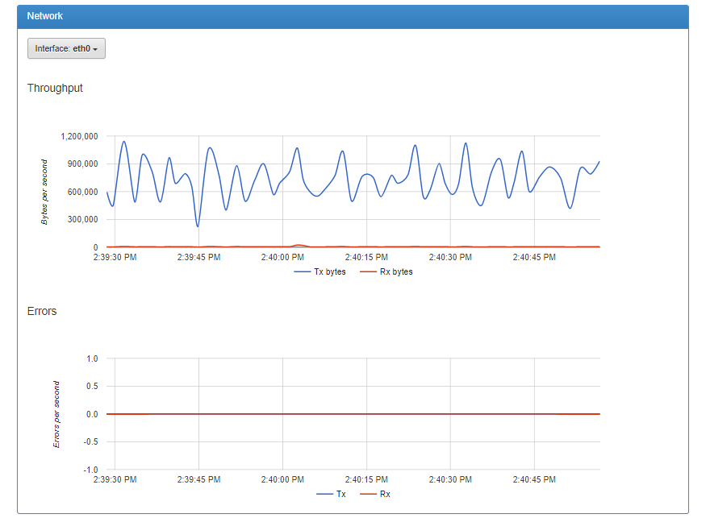
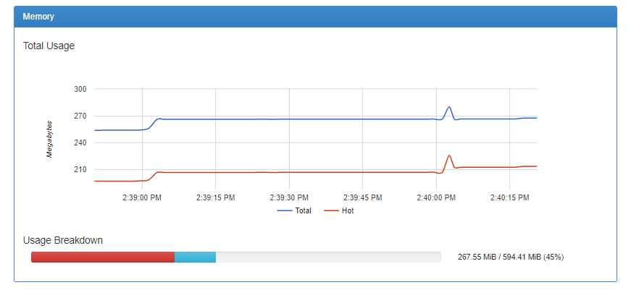
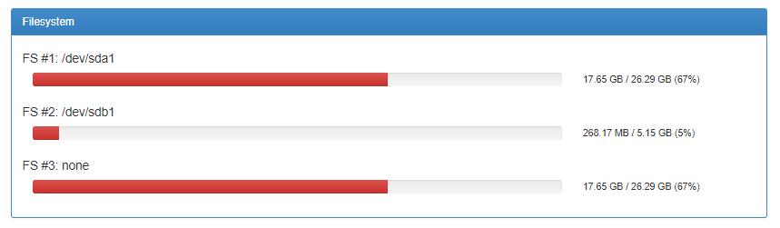
Monitoring Infrastructure in Kubernetes
Notes:
Move this goal to module 2

Slide 14
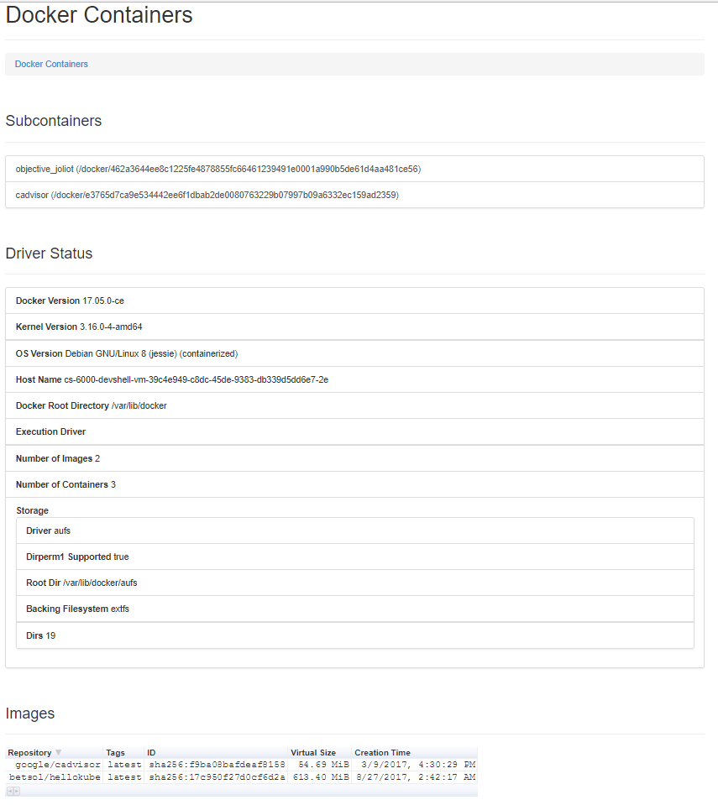
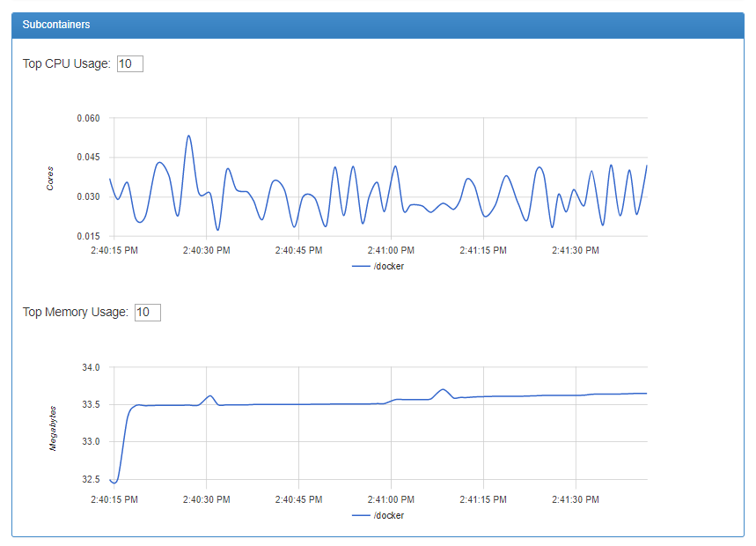
Monitoring Infrastructure in Kubernetes
Notes:
Move this goal to module 2

Slide 15
Monitoring Applications in Kubernetes
Notes:
Move this goal to module 2

Slide 16
Additional Monitoring & Dashboard Tools
Notes:
Move this goal to module 2

Slide 17
DEMO: Monitoring & Dashboard for Containers
Notes:
Move this goal to module 2

Slide 18

THANK YOU!

